Slide 1
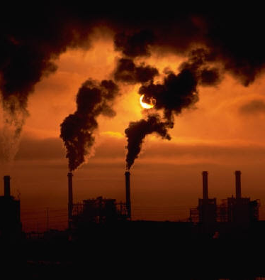
Forecasting Air Quality
Presented by Dinesh Kumar P

Slide 2
Problem Statement
How does humidity affect air quality ?
Objective
Predict the Relative Humidity of a given point of time based on the all-other attributes affecting the change in RH

Slide 3
Data Set
Repository
UCI Machine Learning
Instances 9358
Dependent Variable
Relative Humidity
Independent Variable
Date ; Time ; CO(GT); PT08.S1(CO); NMHC(GT)
C6H6(GT); PT08.S2(NMHC); NOx(GT)
PT08.S3(NOx); NO2(GT); PT08.S4(NO2)
PT08.S5(O3); T; RH; AH

Slide 4
Data Preprocessing
# Removing Unnamed columns
# Changing the datatype from object to float
# Handling null values
# Handling nan values

Slide 5
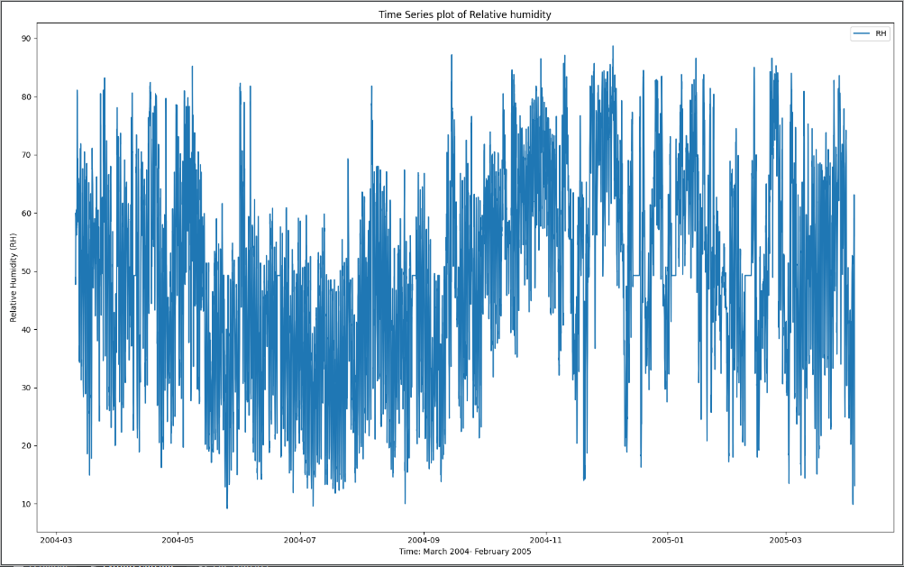
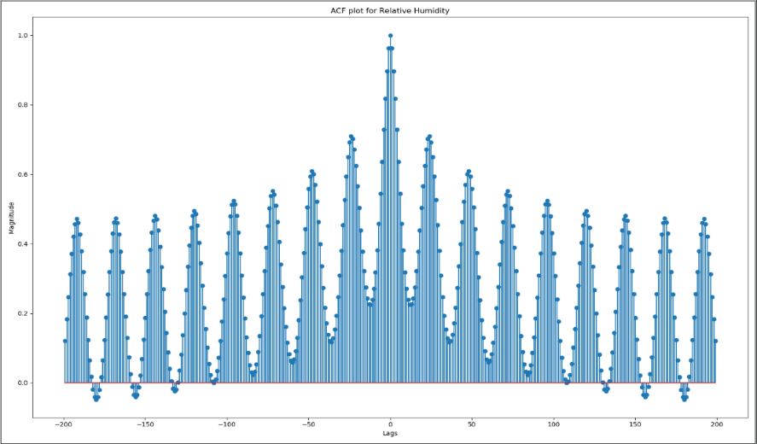
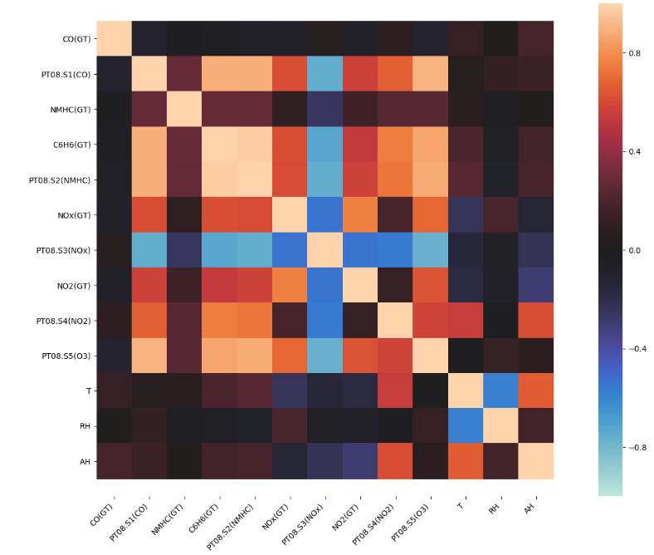
Exploratory Data Analysis(EDA)
RH against time
ACF plots of RH
Correlation Matrix

Slide 6
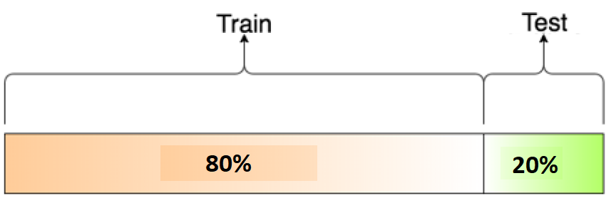
EDA(Continued)
ADF Test Statistic : -7.391164190222852
p-value : 7.993979270510891e-11
#Lags Used : 38
Number of Observations Used : 9318
Train Test Split
Stationarity

Slide 7
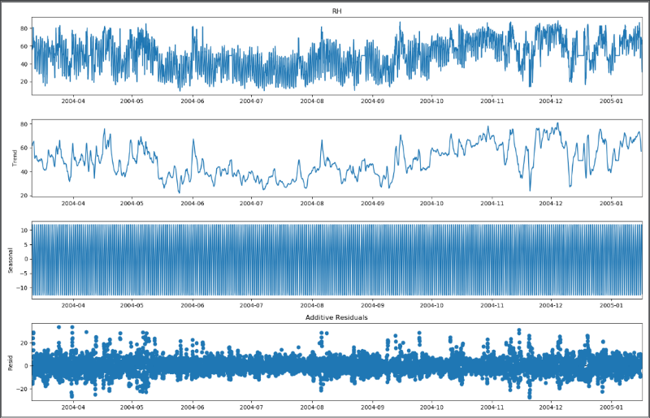
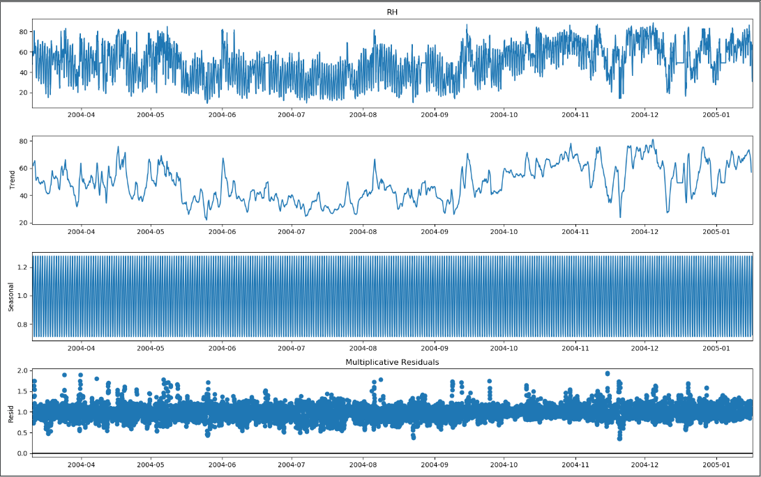
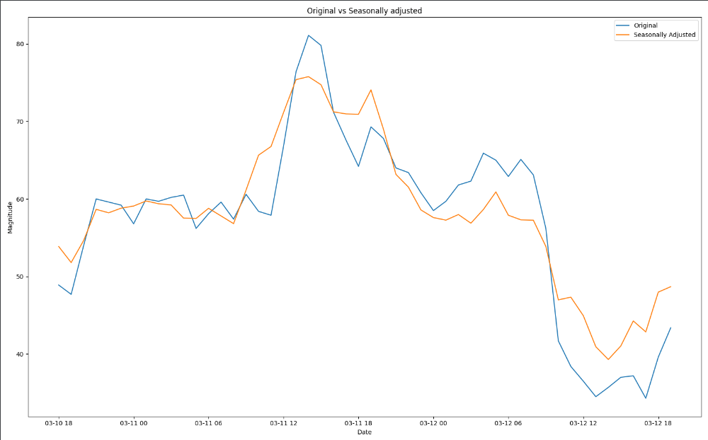
EDA(Continued)
Additive
Multiplicative

Slide 8
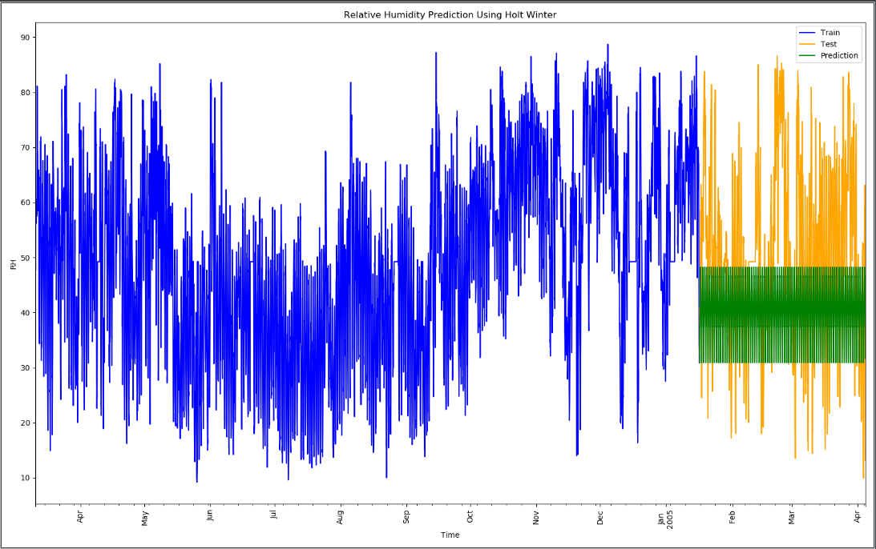
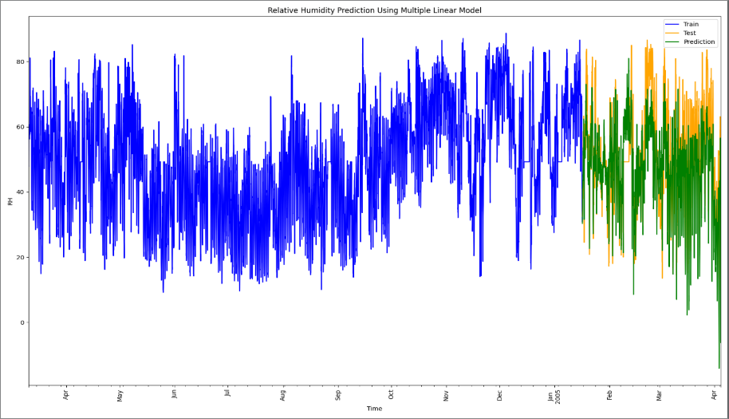
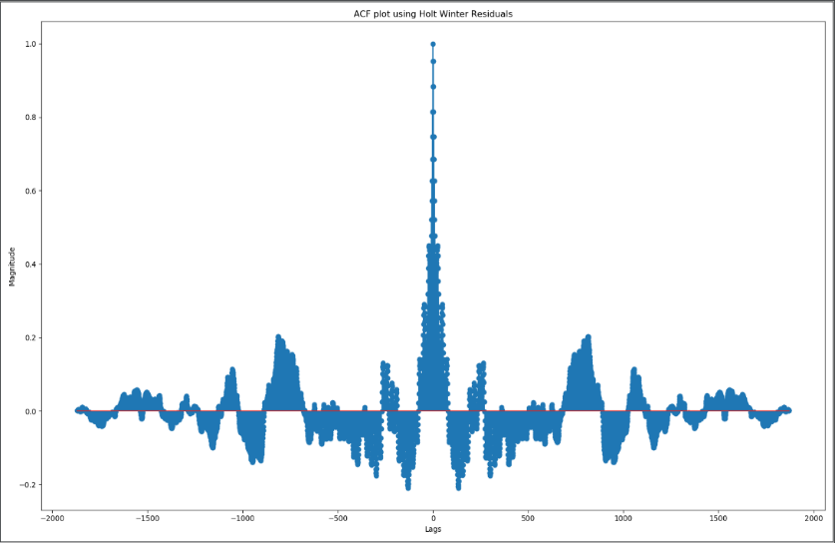
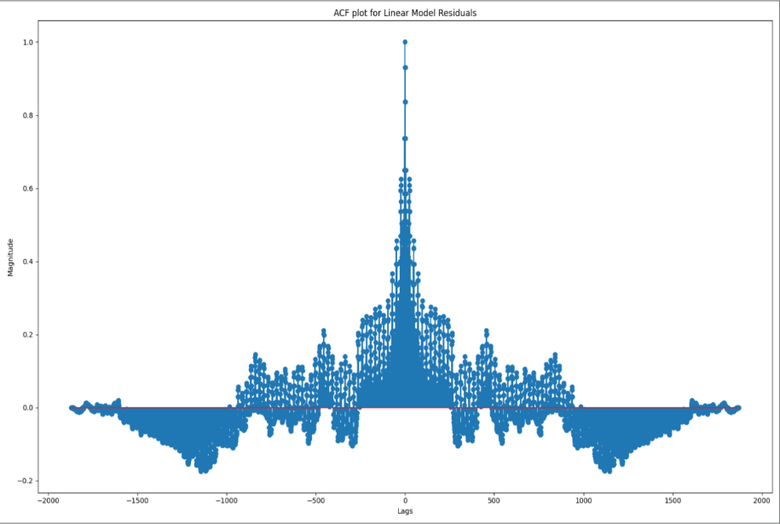
HOLT-WINTER
MULTIPLE LINEAR REGRESSION
Plot of Prediction
Plot of Prediction
ACF residuals
ACF residuals

Slide 9
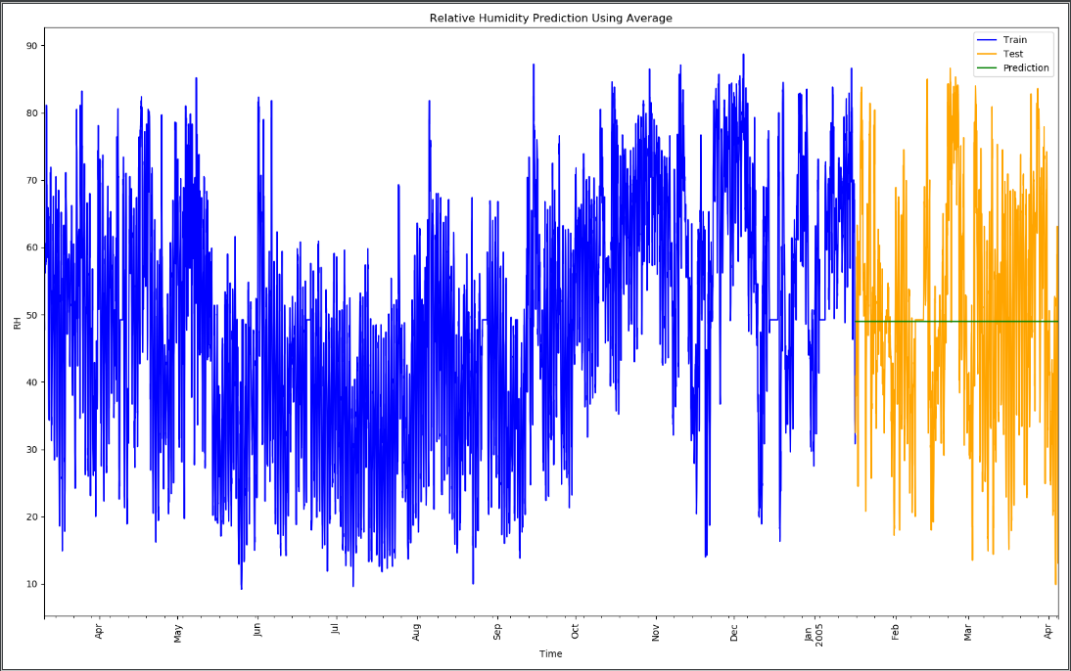
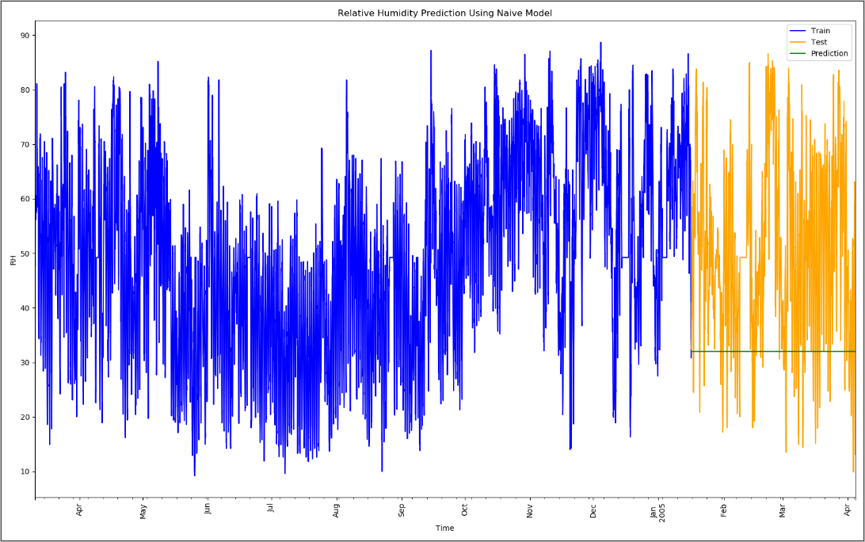
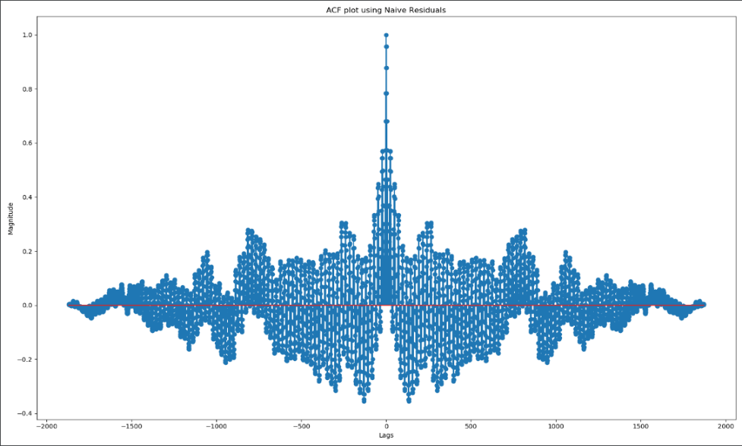
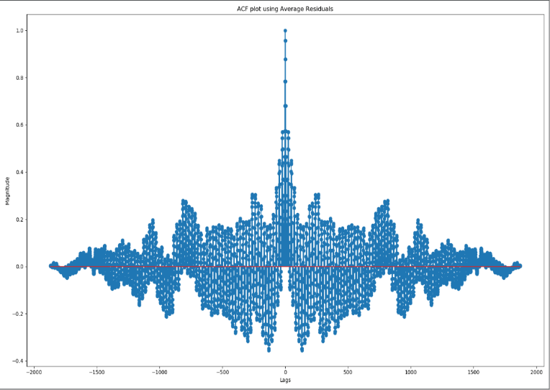
AVERAGE
NAÏVE MODEL
Plot of Prediction
Plot of Prediction
ACF residuals
ACF residuals

Slide 10
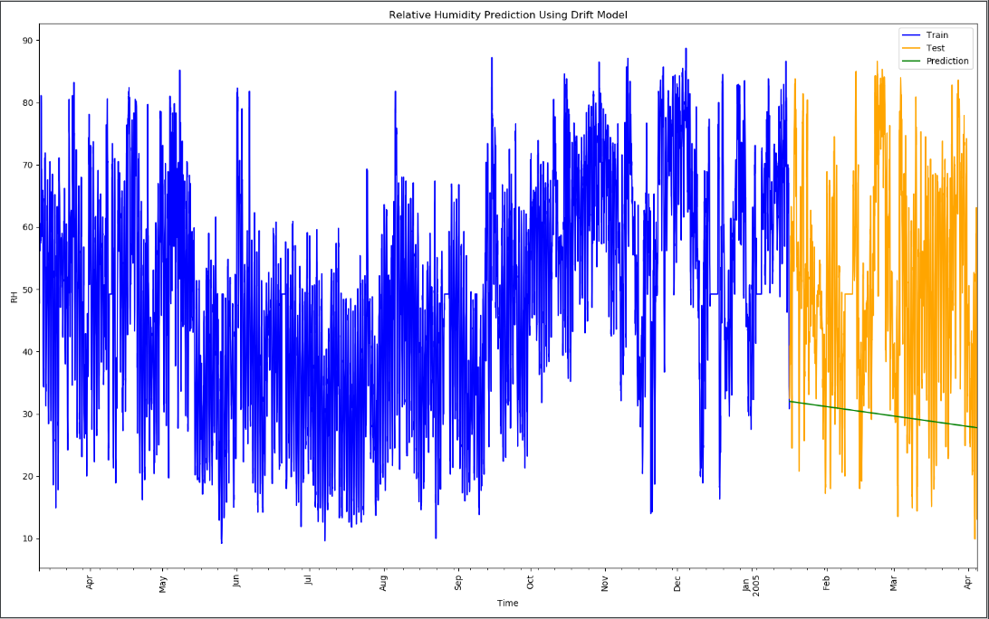
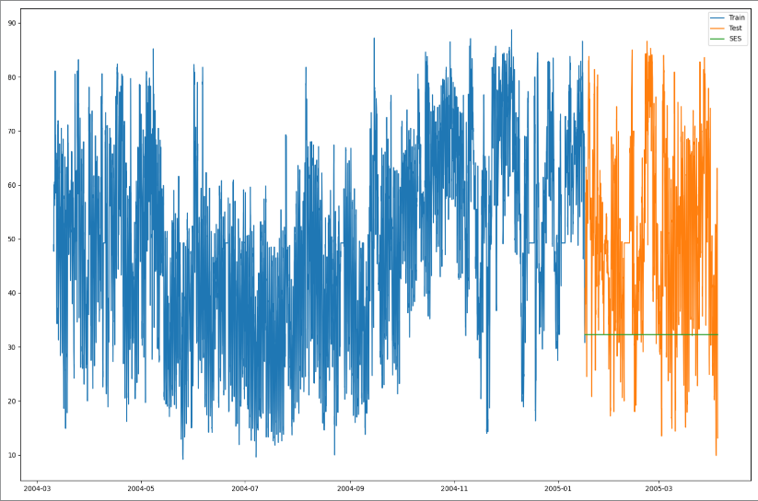
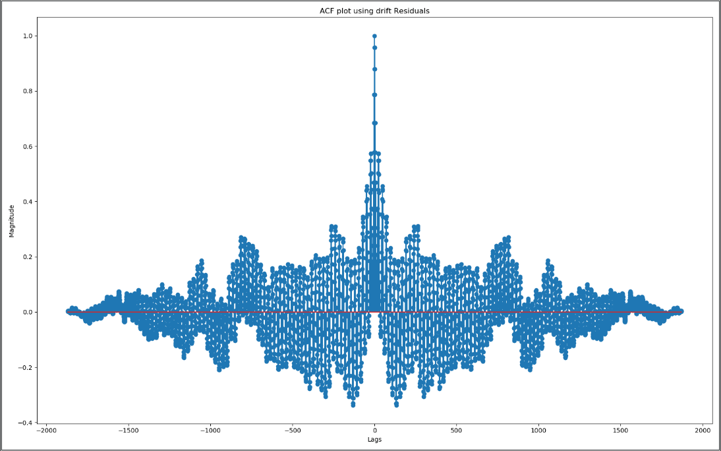

DRIFT
SIMPLE AND EXPONENTIAL SMOOTHING
Plot of Prediction
Plot of Prediction
ACF residuals
ACF residuals

Slide 11
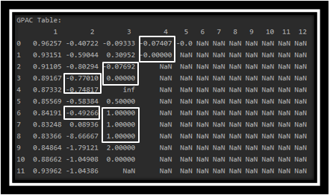
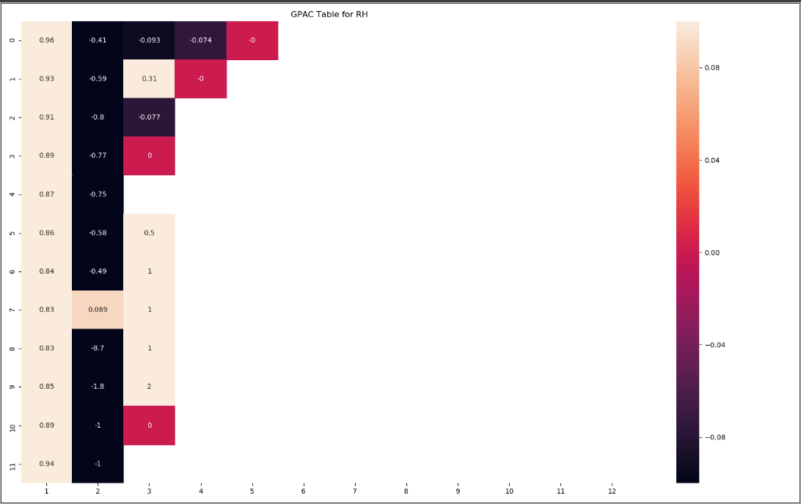
Generalized partial autocorrelation (GPAC)
GPAC TABLE
GPAC HEAT MAP

Slide 12
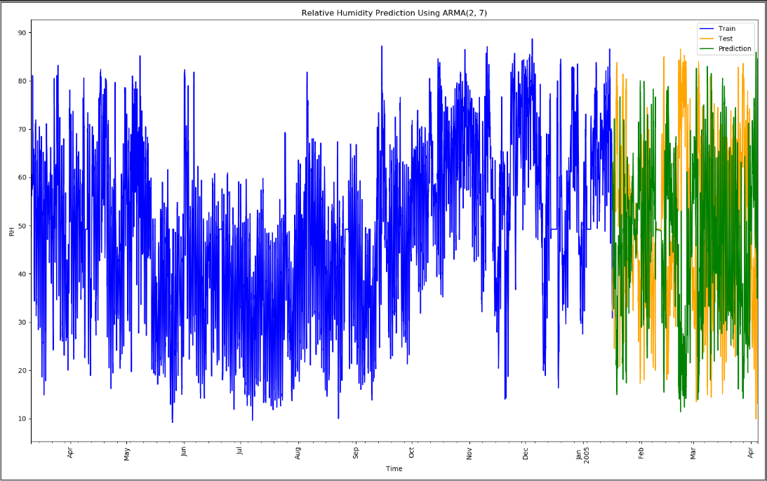
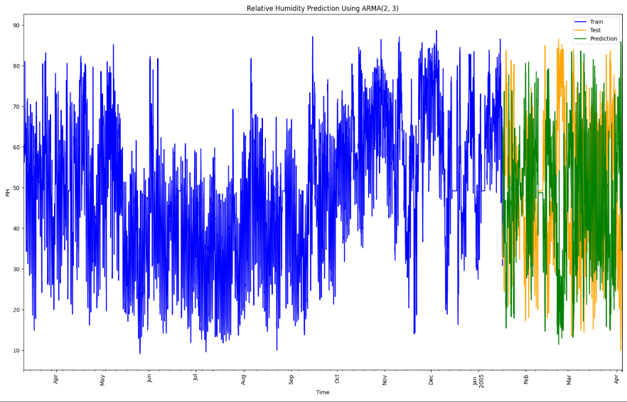


ARMA (2,7) Model
ARMA (2,3) Model
Plot of Prediction
Plot of Prediction
ACF residuals
ACF residuals

Slide 13
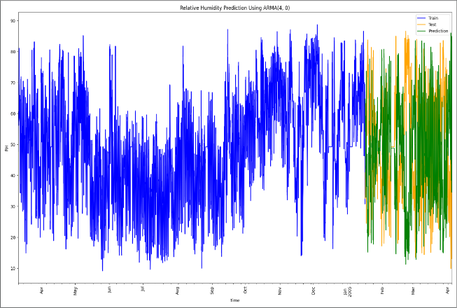

ARMA (4,0) Model
ARMA (4,2) Model
Plot of Prediction
Plot of Prediction
ACF residuals
ACF residuals

Slide 14
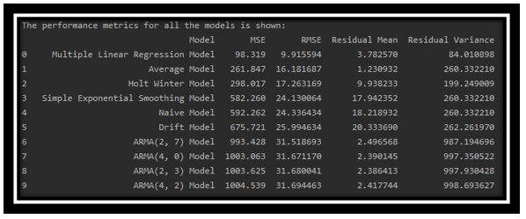
FINAL MODEL SELECTION

Slide 15
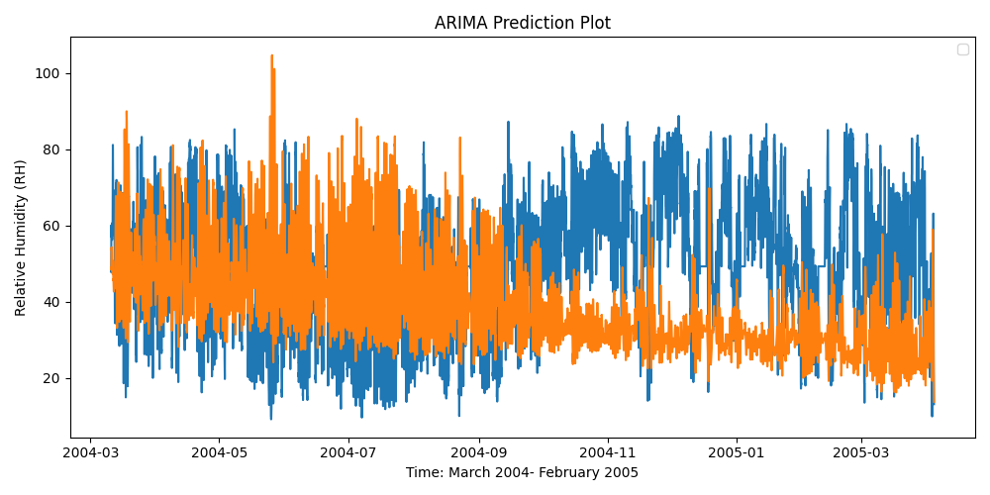
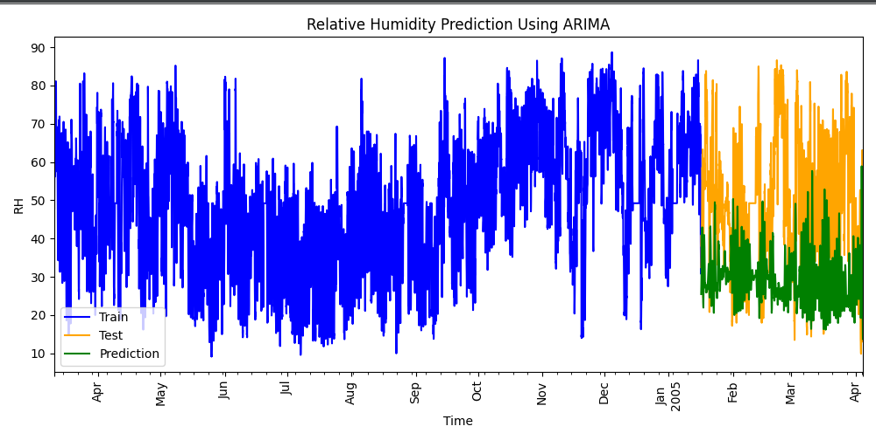
NEXT STEPS…. ARIMA

Slide 16
THANK YOU

